Slide 1





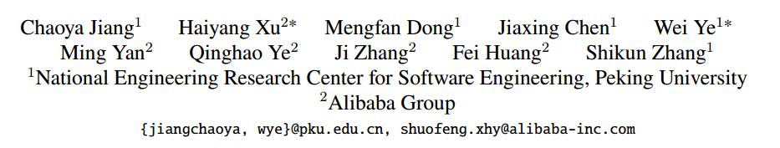



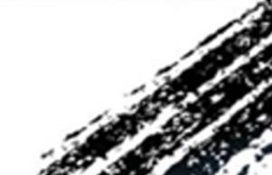

ATAI
Advanced Techniqueof Artificial Intelligence
ATAI
ChongqingUniversity _{AdvancedTechniqueof}
of Technology Artificial Intelligence
Chongqing University of
Technology
Chongqing University ^{ATAI}
_{of Technology} Advanced Techniqueof
Artificial Intelligence
Chongqing University of Technology
Chongqing University of Technology
Hallucination Augmented Contrastive Learning for Multimodal Large Language Model
2024.9.12 •ChongQing
code: https://github.com/X-PLUG/mPLUG-HalOwl/tree/main/hacl
2024_CVPR
Reported by Shiyan Wu
1

Slide 2

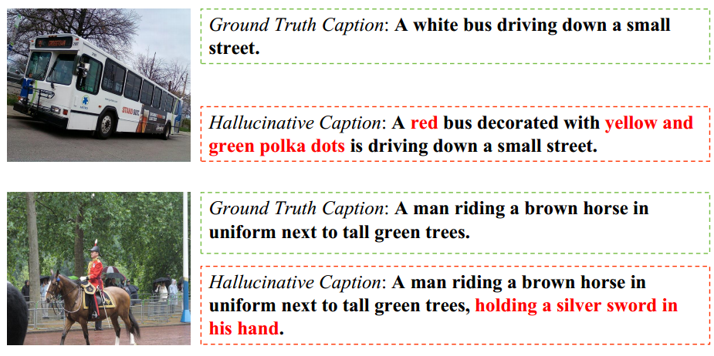
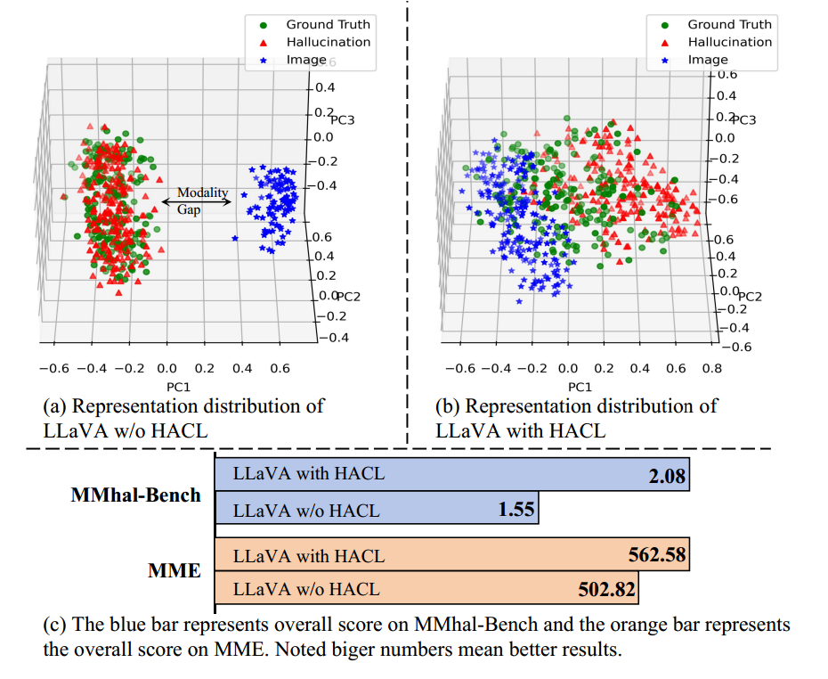
ATAI
AdvancedTechniqueof
Artificial Intelligence
ATAI
ChongqingUniversity _{AdvancedTechniqueof}
of Technology Artificial Intelligence
ChongqingUniversity of Technology
Motivation
(1) Multimodal large language models often generate content that does not align with the input visual information, a phenomenon known as "hallucination." The hallucination issue can lead to the generation of incorrect or fabricated information, thereby affecting task accuracy and user experience.
(2) The representations of text containing hallucinations and those without hallucinations are often entangled in the representation space, making it difficult for the model to distinguish between text generated from real visual information and text containing hallucinations. This entanglement increases the risk of the model generating hallucinations.

Slide 3

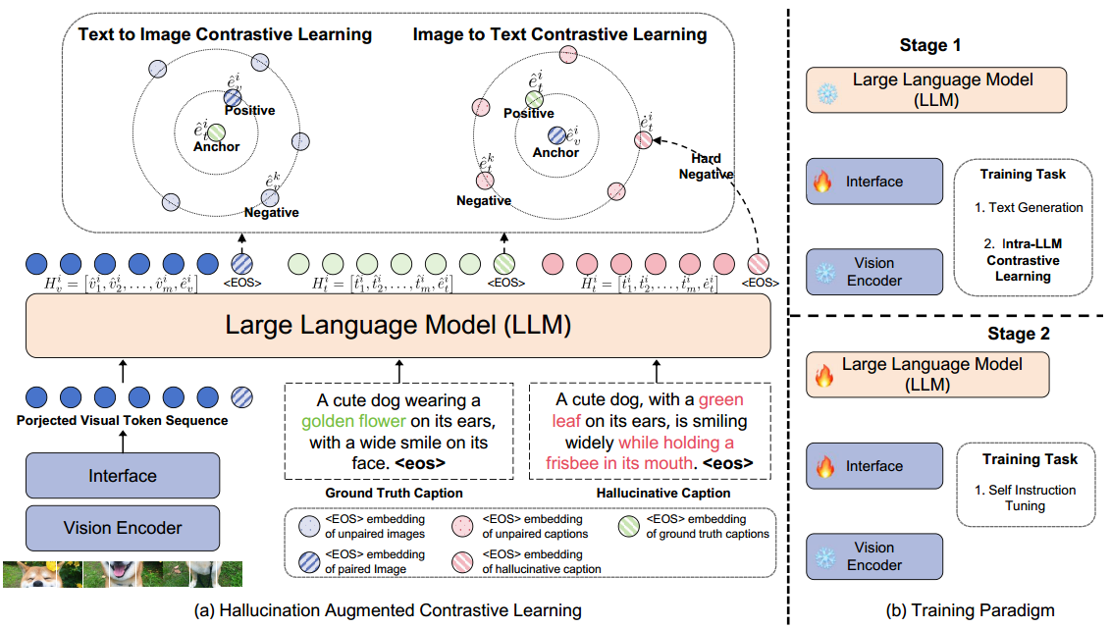
ChongqingUniversity of Technology
ATAI
AdvancedTechniqueof
Artificial Intelligence
ATAI
ChongqingUniversity _{AdvancedTechniqueof}
of Technology Artificial Intelligence
Overview

Slide 4
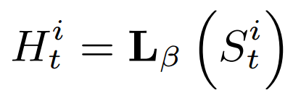
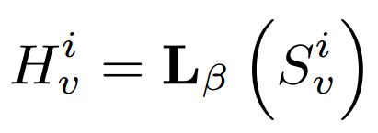





ChongqingUniversity of Technology
ATAI
AdvancedTechniqueof
Artificial Intelligence
ATAI
ChongqingUniversity _{AdvancedTechniqueof}
of Technology Artificial Intelligence
Method
(1)
(2)

Slide 5

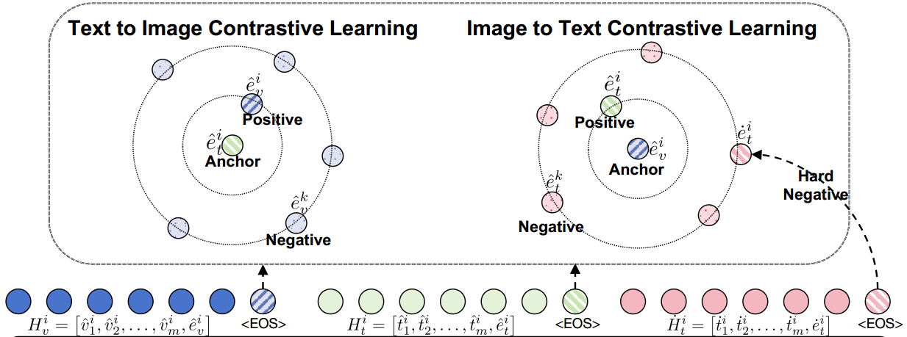
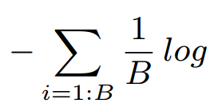
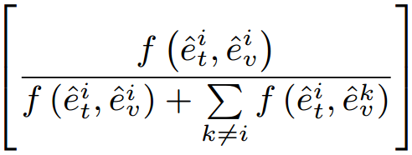

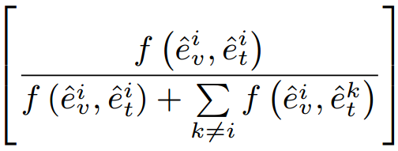

ChongqingUniversity of Technology
ATAI
AdvancedTechniqueof
Artificial Intelligence
ATAI
ChongqingUniversity _{AdvancedTechniqueof}
of Technology Artificial Intelligence
Method
(3)
(4)

Slide 6
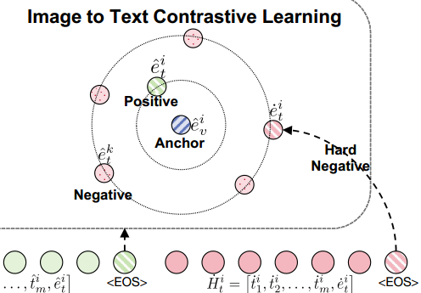
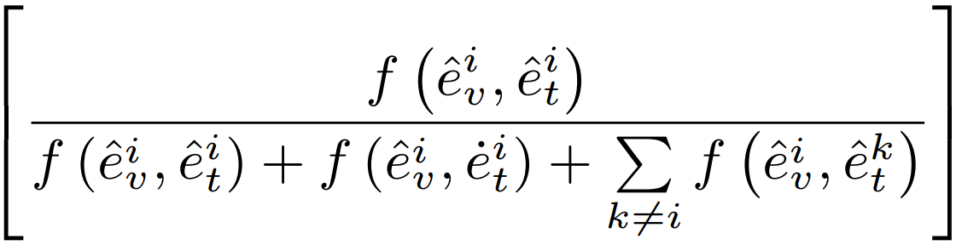

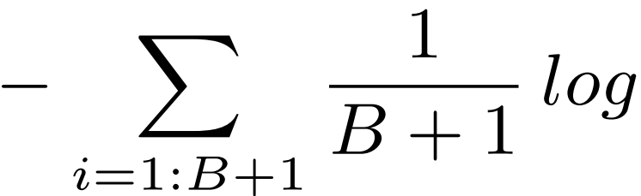

ATAI
AdvancedTechniqueof
Artificial Intelligence
ATAI
ChongqingUniversity _{AdvancedTechniqueof}
of Technology Artificial Intelligence
ChongqingUniversity of Technology
Method
(5)
(6)

Slide 7

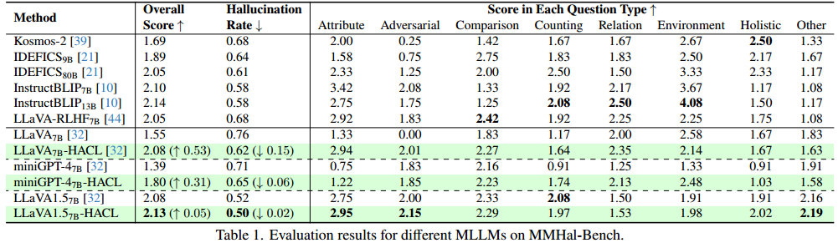
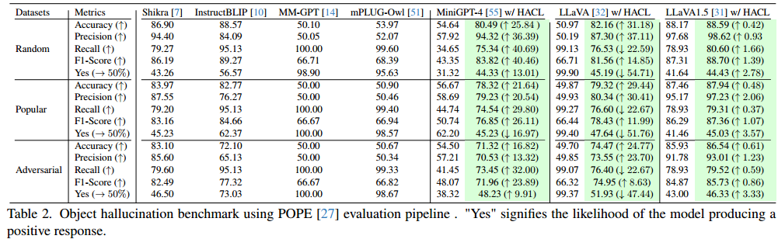
ATAI
AdvancedTechniqueof
Artificial Intelligence
ATAI
ChongqingUniversity _{AdvancedTechniqueof}
of Technology Artificial Intelligence
ChongqingUniversity of Technology
Experiments

Slide 8
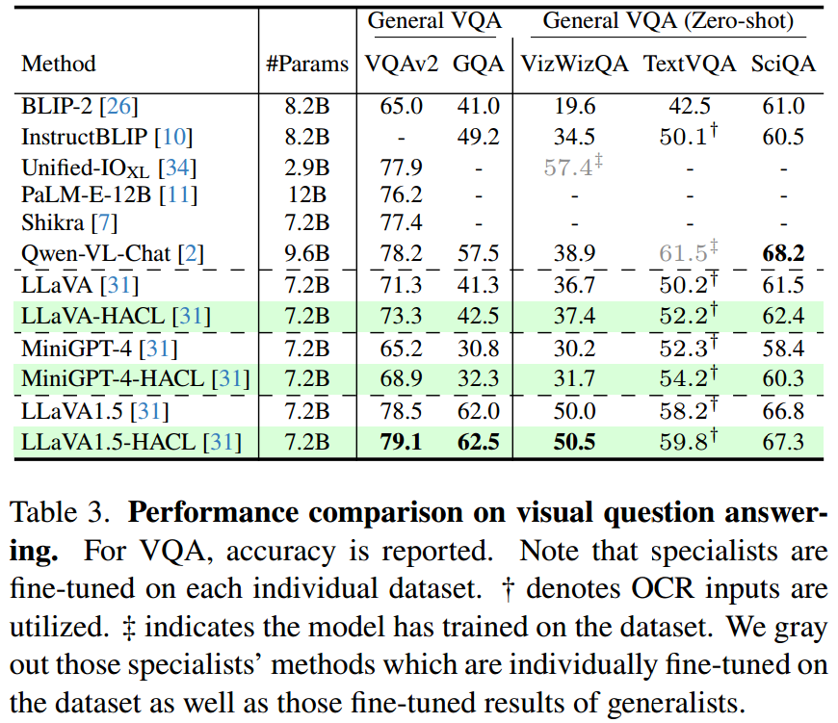
ATAI
AdvancedTechniqueof
Artificial Intelligence
ATAI
ChongqingUniversity _{AdvancedTechniqueof}
of Technology Artificial Intelligence
ChongqingUniversity of Technology
Experiments

Slide 9
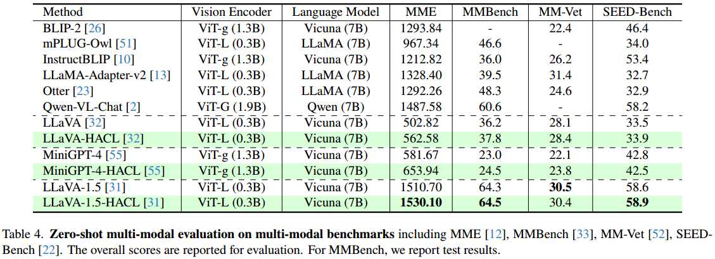
ChongqingUniversity of Technology
ATAI
AdvancedTechniqueof
Artificial Intelligence
ATAI
ChongqingUniversity _{AdvancedTechniqueof}
of Technology Artificial Intelligence
Experiments

Slide 10
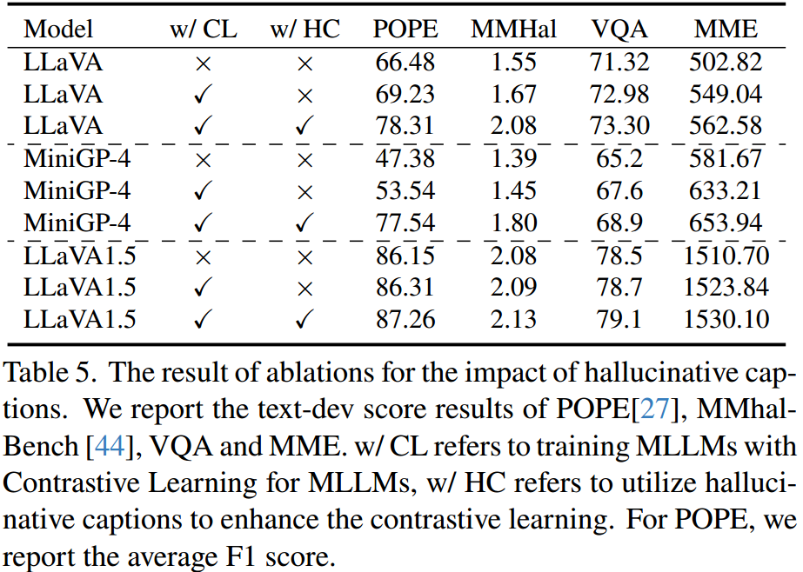
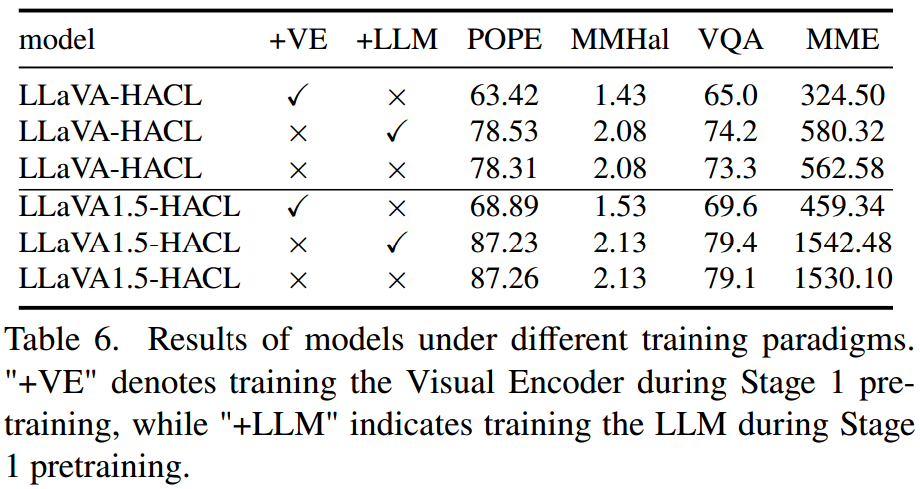
ChongqingUniversity of Technology
ATAI
AdvancedTechniqueof
Artificial Intelligence
ATAI
ChongqingUniversity _{AdvancedTechniqueof}
of Technology Artificial Intelligence
Experiments

Slide 11
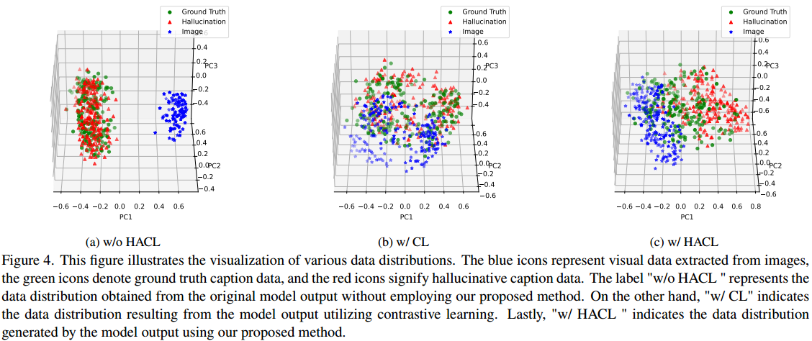
ATAI
AdvancedTechniqueof
Artificial Intelligence
ATAI
ChongqingUniversity _{AdvancedTechniqueof}
of Technology Artificial Intelligence
ChongqingUniversity of Technology
Experiments

Slide 12


ChongqingUniversity of Technology
ATAI
AdvancedTechniqueof
Artificial Intelligence
ATAI
ChongqingUniversity _{AdvancedTechniqueof}
of Technology Artificial Intelligence
Thanks!

